Slide 1
Programming the Basic Computer

Slide 2
Instruction Set of the Basic Computer
Symbol Hex code Description
AND 0 or 8 AND M to AC
ADD 1 or 9 Add M to AC, carry to E
LDA 2 or A Load AC from M
STA 3 or B Store AC in M
BUN 4 or C Branch unconditionally to m
BSA 5 or D Save return address in m and branch to m+1
ISZ 6 or E Increment M and skip if zero
CLA 7800 Clear AC
CLE 7400 Clear E
CMA 7200 Complement AC
CME 7100 Complement E
CIR 7080 Circulate right E and AC

Slide 3
Contd..
CIL 7040 Circulate left E and AC
INC 7020 Increment AC, carry to E
SPA 7010 Skip if AC is positive
SNA 7008 Skip if AC is negative
SZA 7004 Skip if AC is zero
SZE 7002 Skip if E is zero
HLT 7001 Halt computer
INP F800 Input information and clear flag
OUT F400 Output information and clear flag
SKI F200 Skip if input flag is on
SKO F100 Skip if output flag is on
ION F080 Turn interrupt on
IOF F040 Turn interrupt off

Slide 4
Machine Language
A list of instructions that direct the computer to perform a data processing task is called Program
Programs are represented internally in binary form
So any program written in any other language (like C, BASIC, Java, assembly etc.) must be translated to the binary representation of instructions before they can be executed by the computer.
Machine language program is a binary program that runs on a computer directly with out the need of assembler or compiler.
Machine Language:
Binary code: a binary representation of instructions and operands as they appear in computer memory.
Octal or hexadecimal code: translation of binary code to octal or hexadecimal representation.

Slide 5
Program Categories
Binary code:
sequence of instructions and operands in binary that list the exact representation of instructions as they appear in computer memory.
Octal or hexadecimal code:
an equivalent translation of the binary code to octal or hexadecimal representation
Symbolic code (assembly code):
User employs symbols (letters, numerals, or special characters) for the operation part, the address part, and other parts of the instruction code.
Each symbolic instruction can be translated into one binary coded instruction.
This is done by assembler.

Slide 6
Contd..
High-level programming language:
special language developed to reflect the procedures used in the solution of a problem.
Example: FORTRAN, C, JAVA.
The program is written in a sequence of statements in a form that people prefer to think in when solving a program.
Each statement must be translated into a sequence of binary instructions before the program can be executed in a computer.
This is done by compiler or interpreter.

Slide 7
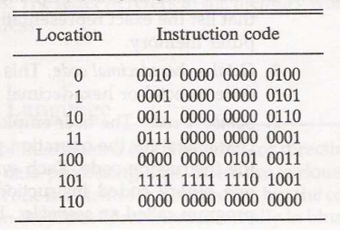
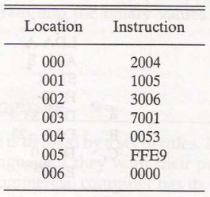
Example
Binary program to add two number
Hexadecimal program to add two number

Slide 8
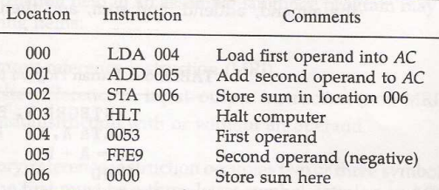
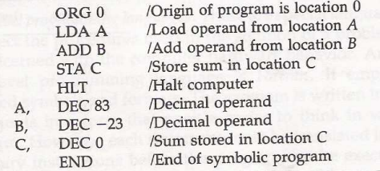
Example
Assembly program to add two numbers
Assembly program in which we replace each hexadecimal address by symbolic address and each hexadecimal operand by a decimal operand

Slide 9
Assembly language
The rules for writing assembly language program
Documented and published in manuals(from the computer manufacturer)
Rules of the Assembly Language
Each line of an assembly language program is arranged in three columns called fields. The fields specify the following information:
1) Label field : empty or symbolic address
2) Instruction field : machine instruction or pseudo instruction
3) Comment field : empty or comment
Example:
Lab, ADD op1 / this is an add operation.
Label Instruction comment
**Note that Label is a symbolic address.

Slide 10
Contd..
Symbolic Address(Label field)
One, two, or three, but not more than three alphanumeric characters
The first character must be a letter; the next two may be letters or numerals
A symbolic address is terminated by a comma(recognized as a label by the assembler)
Instruction Field
1) A memory-reference instruction(MRI)
Example: ADD OPR (direct address MRI), ADD PTR I(indirect address MRI)
2) A register-reference or input-output instruction(non-MRI)
Example: CLA(register-reference), INP(input-output)
3) A pseudo instruction is not a machine instruction but rather an instruction to the assembler giving information about some phase of the translation
Example: ORG, End

Slide 11
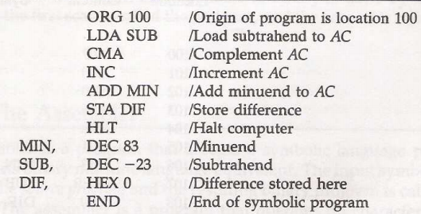
Example
Assembly language program to subtract two numbers

Slide 12
The Assembler
An Assembler is a program that accepts a symbolic language and produces its binary machine language equivalent.
The input symbolic program :Source program.
The resulting binary program: Object program.
Prior to assembly, the program must be stored in the memory.
A line of code is stored in consecutive memory locations with two characters in each location. (each character 8 bits)→ memory word 16 bits

Slide 13
First Pass
The assembler scans the symbolic program twice.
First pass: generates an “Address Symbol Table” that connects all user-defined address symbols with their binary equivalent value.
Second Pass: Binary translation
To keep track of instruction locations: the assembler uses a memory word called a location counter (LC).
LC stores the value of the memory location assigned to the instruction or operand presently being processed.
LC is initialized to the first location using the ORG pseudo instruction. If there is no ORG→ LC = 0

Slide 14
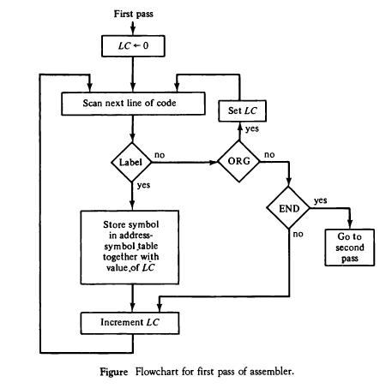
First Pass (Contd..)

Slide 15
Second Pass
Machine instructions are translated in this pass by means of a table lookup procedure.
A search of table entries is performed to determine whether a specific item matches one of the items stored in the table.

Slide 16
Assembler Tables
Four tables are used:
Pseudoinstruction table. (ORG, DEC, HEX, END)
MRI table. (7 symbols for memory reference and 3-bit opcode equivalent)
Non-MRI table. (18 Reg. & I/O instruction and 16-bit binary code equivalent)
Address symbol table. (Generated during first pass)

Slide 17
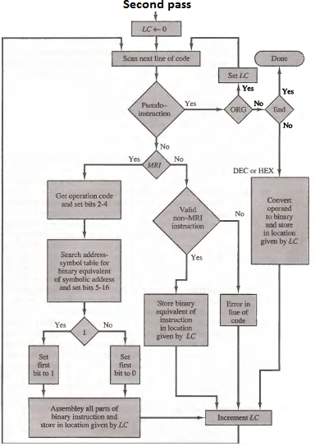

Slide 18
Error Diagnostics
One important task of the assembler is to check for possible errors in the symbolic program.
Example:
Invalid machine code symbol.
A symbolic address that did not appear as a label.

Slide 19
Program Loops
A sequence of instructions that are executed many times, each time with a different set of data

Slide 20
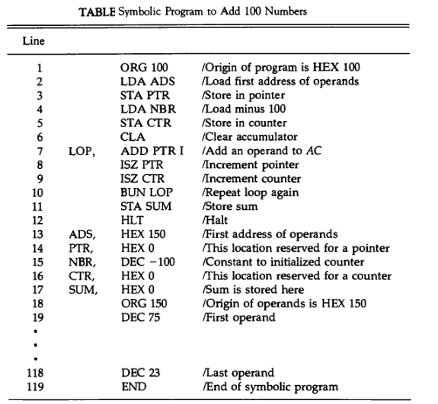

Slide 21
Programming Arithmetic & Logic Operations
Software Implementation
- Implementation of an operation with a program using machine instruction set
- Usually used: when the operation is not included in the instruction set
Hardware Implementation
- Implementation of an operation in a computer with one machine instruction

Slide 22
Multiplication
We will develop a program to multiply two numbers.
Assume positive numbers and neglect the sign bit for simplicity.
Also, assume that the two numbers have no more than 8 significant bits → 16-bit product.

Slide 23
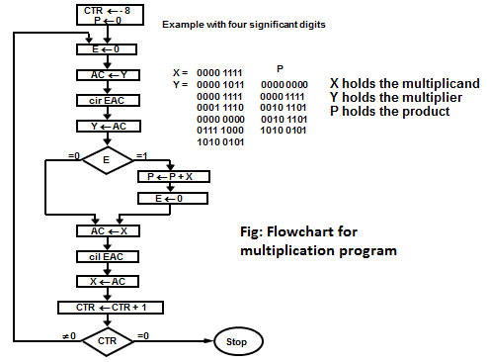

Slide 24
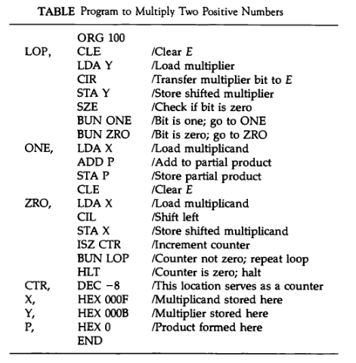

Slide 25
Double-Precision Addition
When two 16-bit unsigned numbers are multiplied, the result is a 32-bit product that must be stored in two memory words.
A number stored in two memory words is said to have double precision.
When a partial product is computed, it is necessary to add a double-precision number to the shifted multiplicand, which is also double-precision.
This provides better accuracy
One of the double precision numbers is stored in two consecutive memory locations, AL & AH. The other number is placed in BL & BH.
The two low-order portions are added and the carry is transferred to E. The AC is cleared and E is circulated into the LSB of AC.
The two high-order portions are added and the sum is stored in CL & CH.

Slide 26
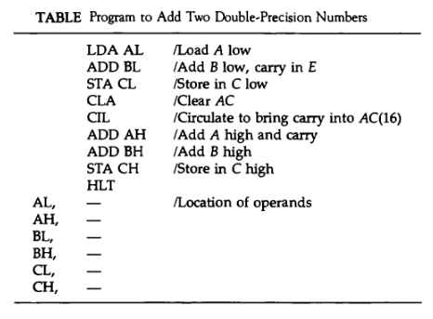
Double-Precision Addition

Slide 27
Logic Operations
All 16 logic operations (table 4-6) can be implemented using the AND & complement operations.
Example: OR : x + y = (x’.y’)’ De-morgan’s
LDA A
CMA
STA TMP
LDA B
CMA
AND TMP
CMA
/ Load 1st operand
/ Complement to get A’
/ Store in a temporary location
/ Load 2nd operand B
/ Complement to get B’
/ AND with A’ to get A’ AND B’
/ Complement again to get A OR B

Slide 28
Shift Operations
The circular shift operations are machine instructions in the basic computer.
Logical and Arithmetic shifts can be programmed with a small number of instructions.

Slide 29
Logical Shift Operations
Logical shift right
CLE
CIR
Logical shift left
CLE
CIL

Slide 30
Arithmetic Shift Operations
Arithmetic shift right: it is necessary that the sign bit in the leftmost position remain unchanged. But the sign bit itself is shifted into the high-order bit position of the number.
CLE / Clear E to 0 SPA / Skip if AC is positive, E remains 0 CME / AC is negative, set E to 1 CIR / Circulate E and AC

Slide 31
Arithmetic Shift Operations /cont.
Arithmetic shift left: it is necessary that the added bit in the LSB be 0.
CLE CIL
The sign bit must not change during this shift.
With a circulate instruction, the sign bit moves into E.

Slide 32
Arithmetic Shift Operations /cont.
The sign bit has to be compared with E after the operation to detect overflow.
If the two values are equal → No overflow.
If the two values are not equal → Overflow.

Slide 33
Subroutines
The same piece of code might be written again in many different parts of a program.
Write the common code only once.
Subroutines :A set of common instructions that can be used in a program many times
Each time a subroutine is used in the main program, a branch is made to the beginning of the subroutine. The branch can be made from any part of the main program.

Slide 34
Subroutines /cont.
After executing the subroutine, a branch is made back to the main program.
It is necessary to store the return address somewhere in the computer for the subroutine to know where to return.
In the basic computer, the link between the main program and a subroutine is the BSA instruction.

Slide 35
Subroutines example- (CIL 4 times)
Loc.
100
101
102
103
104
105
106
107
108
109
10A
10B
10C
10D
10E
10F
110
X,
Y,
SH4,
MSK,
ORG 100
LDA X
BSA SH4
STA X
LDA Y
BSA SH4
STA Y
HLT
HEX 1234
HEX 4321
HEX 0
CIL
CIL
CIL
CIL
AND MSK
BUN SH4 I
HEX FFF0
END
/ Main program
/ Load X
/ Branch to subroutine
/ Store shifted number
/ Load Y
/ Branch to subroutine again
/ Store shifted number
/ Subroutine to shift left 4 times
/ Store return address here
/ Circulate left once
/ Circulate left fourth time
/ Set AC(13-16) to zero
/ Return to main program
/ Mask operand

Slide 36
Subroutines /cont.
The first memory location of each subroutine serves as a link between the main program and the subroutine.
The procedure for branching to a subroutine and returning to the main program is referred to as a subroutine linkage.
The BSA instruction performs the call.
The BUN instruction performs the return.

Slide 37
Subroutine Parameters and Data Linkage
When a subroutine is called, the main program must transfer the data it wishes the subroutine to work with.
It is necessary for the subroutine to have access to data from the calling program and to return results to that program.
The accumulator can be used for a single input parameter and a single output parameter.

Slide 38
Subroutine Parameters and Data Linkage /cont.
In computers with multiple processor registers, more parameters can be transferred this way.
Another way to transfer data to a subroutine is through the memory.
Data are often placed in memory locations following the call.

Slide 39
Parameter Linkage
Loc.
200
201
202
203
204
205
206
207
208
209
20A
20B
20C
20D
20E
20F
210
X,
Y,
OR,
TMP,
ORG 200
LDA X
BSA OR
HEX 3AF6
STA Y
HLT
HEX 7B95
HEX 0
HEX 0
CMA
STA TMP
LDA OR I
CMA
AND TMP
CMA
ISZ OR
BUN OR I
HEX 0
END
/ Load 1st operand into AC
/ Branch to subroutine OR
/ 2nd operand stored here
/ Subroutine returns here
/ 1st operand stored here
/ Result stored here
/ Subroutine OR
/ Complement 1st operand
/ Store in temporary location
/ Load 2nd operand
/ Complement 2nd operand
/ AND complemented 1st operand
/ Complement again to get OR
/ Increment return address
/ Return to main program
/ Temporary storage

Slide 40
Subroutine Parameters and Data Linkage /cont.
It is possible to have more than one operand following the BSA instruction.
The subroutine must increment the return address stored in its first location for each operand that it extracts from the calling program.

Slide 41
Data Transfer
If there is a large amount of data to be transferred, the data can be placed in a block of storage and the address of the first item in the block is then used as the linking parameter.
SUBROUTINE MVE (SOURCE, DEST, N)
DIMENSION SOURCE(N), DEST(N)
DO 20 I = 1, N
DEST(I) = SOURCE(I)
RETURN
END

Slide 42
Data transfer
MVE,
LOP,
PT1,
PT2,
CTR,
BSA MVE
HEX 100
HEX 200
DEC -16
HLT
HEX 0
LDA MVE I
STA PT1
ISZ MVE
LDA MVE I
STA PT2
ISZ MVE
LDA MVE I
STA CTR
ISZ MVE
LDA PT1 I
STA PT2 I
ISZ PT1
ISZ PT2
ISZ CTR
BUN LOP
BUN MVE I
--
--
--
/ Main program
/ Branch to subroutine
/ 1st address of source data
/ 1st address of destination data
/ Number of items to move
/ Subroutine MVE
/ Bring address of source
/ Store in 1st pointer
/ Increment return address
/ Bring address of destination
/ Store in 2nd pointer
/ Increment return address
/ Bring number of items
/ Store in counter
/ Increment return address
/ Load source item
/ Store in destination
/ Increment source pointer
/ Increment destination pointer
/ Increment counter
/ Repeat 16 times
/ Return to main program

Slide 43
Input-Output Programming
Users of the computer write programs with symbols that are defined by the programming language used.
The symbols are strings of characters and each character is assigned an 8-bit code so that it can be stored in a computer memory.

Slide 44
Input-Output Programming /cont.
A binary coded character enters the computer when an INP instruction is executed.
A binary coded character is transferred to the output device when an OUT instruction is executed.

Slide 45
Character Input
Program to Input one Character(Byte)
CIF,
CHR,
SKI
BUN CIF
INP
OUT
STA CHR
HLT
--
/ Check input flag
/ Flag=0, branch to check again
/ Flag=1, input character
/ Display to ensure correctness
/ Store character
/ Store character here

Slide 46
Character Output
Program to Output a Character
COF,
CHR,
LDA CHR
SKO
BUN COF
OUT
HLT
HEX 0057
/ Load character into AC
/ Check output flag
/ Flag=0, branch to check again
/ Flag=1, output character
/ Character is "W"

Slide 47
Character Manipulation
The binary coded characters that represent symbols can be manipulated by computer instructions to achieve various data-processing tasks.
One such task may be to pack two characters in one word.
This is convenient because each character occupies 8 bits and a memory word contains 16 bits.

Slide 48
Subroutine to Input 2 Characters and pack into a word
IN2,
FST,
SCD,
--
SKI
BUN FST
INP
OUT
BSA SH4
BSA SH4
SKI
BUN SCD
INP
OUT
BUN IN2 I
/ Subroutine entry
/ Input 1st character
/ Logical Shift left 4 bits
/ 4 more bits
/ Input 2nd character
/ Return

Slide 49
Table lookup
A two pass assembler performs the table lookup in the second pass.
This is an operation that searches a table to find out if it contains a given symbol.
The search may be done by comparing the given symbol with each of the symbols stored in the table.

Slide 50
Table lookup /cont.
The search terminates when a match occurs or if none of the symbols match.
The comparison is done by forming the 2’s complement of a word and arithmetically adding it to the second word.
If the result is zero, the two words are equal and a match occurs. Else, the words are not the same.

Slide 51
Table Lookup / cont.
Comparing two words:
WD1,
WD2,
LDA WD1
CMA
INC
ADD WD2
SZA
BUN UEQ
BUN EQL
---
---
/ Load first word
/ Form 2’s complement
/ Add second word
/ Skip if AC is zero
/ Branch to “unequal” routine
/ Branch to “equal” routine

Slide 52
Program Interrupt
The running time of input and output programs is made up primarily of the time spent by the computer in waiting for the external device to set its flag.
The wait loop that checks the flags wastes a large amount of time.
Use interrupt facility to notify the computer when a flag is set → eliminates waiting time.

Slide 53
Program Interrupt /cont.
Data transfer starts upon request from the external device.
Only one program can be executed at any given time.
Running program: is the program currently being executed
The interrupt facility allows the running program to proceed until the input or output device sets its ready flag

Slide 54
Program Interrupt /cont.
When a flag is set to 1: the computer completes the execution of the instruction in progress and then acknowledges the interrupt.
The return address is stored in location 0.
The instruction in location 1 is performed: this initiates a service routine for the input or output transfer.
The service routine can be stored anywhere in memory provided a branch to the start of the routine is stored in location 1.

Slide 55
Service Routine
Must have instructions to perform:
Save contents of processor registers.
Check which flag is set.
Service the device whose flag is set.
Restore contents of processor registers
Turn the interrupt facility on.
Return to the running program.

Slide 56
Service Routine /cont.
The contents of processor registers before and after the interrupt must be the same.
Since the registers may be used by the service routine, it is necessary to save their contents at the beginning of the routine and restore them at the end.

Slide 57
Service Routine /cont.
The sequence by which flags are checked dictates the priority assigned to each device.
The device with higher priority is serviced first.
Even though two or more flags may be set at the same time, the devices are serviced on at a time.

Slide 58
Service Routine /cont.
The occurrence of an interrupt disables the facility from further interrupts.
The service routine must turn the interrupt on before the return to the running program.
The interrupt facility should not be turned on until after the return address is inserted into the program counter.

Slide 59
Interrupt Service Program
Location
0
1
100
101
102
103
104
200
ZRO,
SRV,
NXT,
EXT,
SAC,
SE,
PT1,
PT2,
-
BUN SRV
CLA
ION
LDA X
ADD Y
STA Z
STA SAC
CIR
STA SE
SKI
BUN NXT
INP
OUT
STA PT1 I
ISZ PT1
SKO
BUN EXT
LDA PT2 I
OUT
ISZ PT2
LDA SE
CIL
LDA SAC
ION
BUN ZRO I
-
-
-
-
/ Return address stored here
/ Branch to service routine
/ Portion of running program
/ Turn on interrupt facility
/ Interrupt occurs here
/ Program returns here after interrupt
/ Interrupt service routine
/ Store content of AC
/ Move E into AC(1)
/ Store content of E
/ Check input flag
/ Flag is off, check next flag
/ Flag is on, input character
/ Print character
/ Store it in input buffer
/ Increment input pointer
/ Check output flag
/ Flag is off, exit
/ Load character from output buffer
/ Output character
/ Increment output pointer
/ Restore value of AC(1)
/ Shift it to E
/ Restore content of AC
/ Turn interrupt on
/ Return to running program
/ AC is stored here
/ E is stored here
/ Pointer of input buffer
/ Pointer of output buffer

